Slide 1
CS 357 – Numerical Methods 1
Prof. Mariana Silva
Fall 2020

Slide 2
Course overview
Course website:
Syllabus
Schedule
Resources
Office hours queue
Python tutorial
PrairieLearn demo:
Lecture Activity
Group Activity
HW
Quiz

Slide 3
CBTF Online
Online proctoring with Zoom and CBTF proctors
How does it work?
Make a reservation in the CBTF Scheduler.
Visit the Scheduler near your reservation time to check in and receive further instructions, including the link to the Zoom meeting for your proctoring.
Join the Zoom meeting from your phone and position it to view you taking your exam. The proctor is present to help get you set up, answer questions, etc.
Once checked in, you will be given instructions via the Scheduler on how to take the exam.

Slide 4
CBTF Online
Visit cbtf.engr.illinois.edu
Full instructions
FAQ
Walkthrough of check-in process
Conflict exam request form
CBTF Scheduler
Still have questions or concerns? Chat, ask questions, and get to know the proctors during our regularly scheduled Fall 2020 CBTF Proctor Office Hours:
Mon, 5:30 pm - 6:30 pm CST
Tue, 12:00 pm - 1:00 pm CST
Wed, 5:30 pm - 6:30 pm CST
Thu, 7:30 pm - 8:30 pm CST
Fri, 12:00 pm - 1:00 pm CST
Sat, 5:30 pm - 6:30 pm CST
Sun, 7:30 pm - 8:30 pm CST

Slide 5
Introduction and “Big Idea”

Slide 6
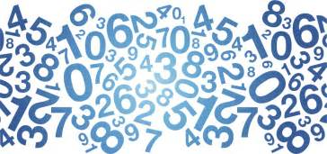

Numerical Methods ?
What are…
Numbers in a computer
(and how computer understands these numbers)
Mathematical model
“algorithms” derived from math ideas to solve equations numerically
Complexity of the problem
Slow vs fast
Accuracy
Accurate vs inaccurate
Method = Math + Complexity + Accuracy
Notes:
How can a method that described an exact math problem can be inaccurate? We need to know how to deal with such introduced errors.

Slide 7
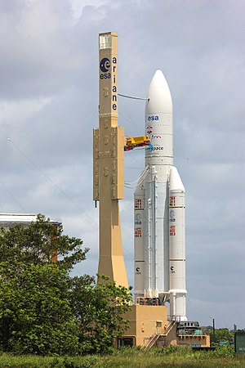
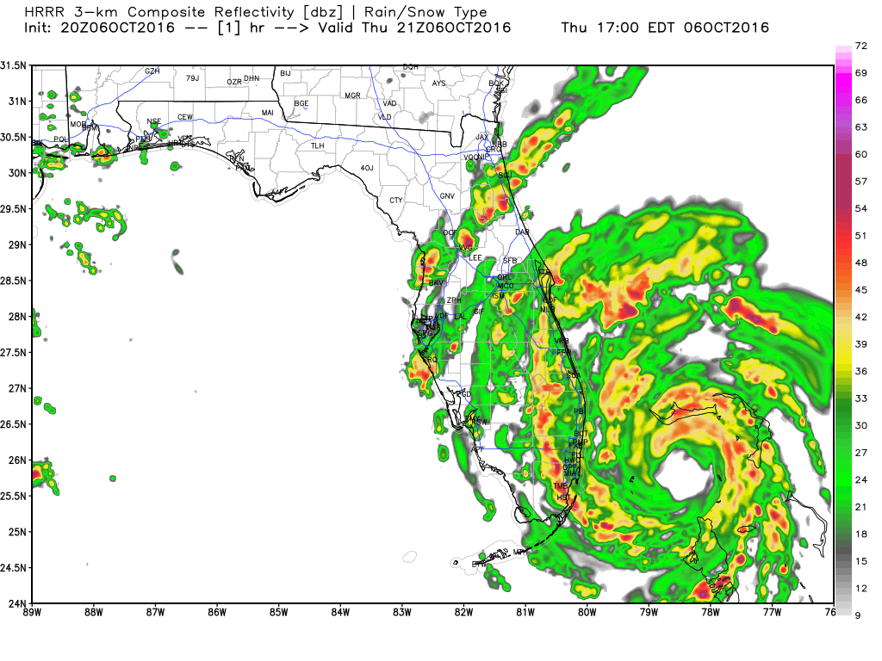
Why is this course important?
Understanding and reconstruction of known problems
Natural disasters
Catastrophic failures
Prediction of unknown situations
Weather conditions
Behavior of new materials
Optimization of existing problems
Image recognition
Reduce fabrication costs
Explosion of Ariane 5 in 1996
Notes:
Ariane-5-explosion: Self-destruction was caused by a data type conversion and therefore incorrect representation of real numbers

Slide 8
Goals for this course
Understand how numbers are represented in the computer.
When developing code, you will likely run into numerical errors. What are the sources of these errors?
How can you avoid numerical errors?
How can you choose a suitable algorithm for a given application?
Use existing libraries to solve real applications.

Slide 9
(Numerical) Method = Math + Complexity + Accuracy
Mathematical model:
What equations can we use to represent our problem?
Accuracy:
Are we getting accurate results?
Why is the method not giving me the correct solution?
Complexity:
How long does it take to solve this problem?
Is it cost-effective?

Slide 10
Your entire CS 357 semester in a few slides!
Are you ready?

Slide 11
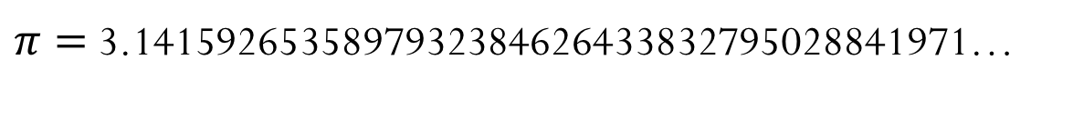
Accuracy
Why a numerical method might not give the right answer?
Computers have finite representation of numbers
Sometimes the “right answer” cannot be represented in a finite way
Example:
$π=$3.1415926535897932384626433832795028841971…

Slide 12
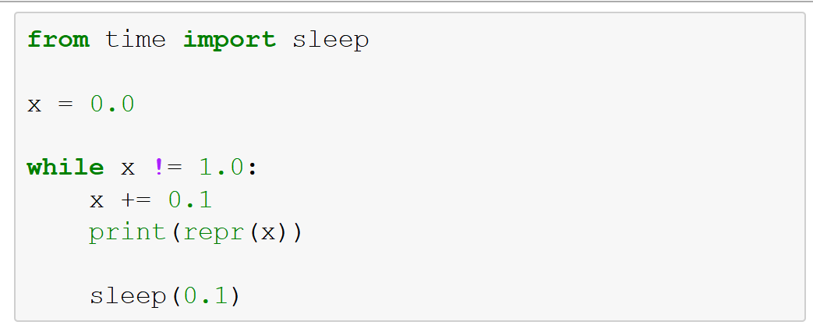
Demo: Waiting for the number 1
What is going to happen when we run this code?
Code will stop after printing 11 values for x
Code will stop after printing 10 values for x
Code will not stop
Code will not start

Slide 13
Monte Carlo Methods
Texas Holdem Game: we would like to determine the probability of winning of a given starting hand
Physical experiment
vs
Numerical experiment

Slide 14
Numerical Experiments
What do we want to know about a numerical experiment?
What questions are we attempting to answer?
What is the outcome of the experiment?
Is it repeatable?
Is the answer accurate?
How long will it take?
Time vs accuracy trade-off
Question: Is running this method (with a certain accuracy) a good use of our time and/or computer resources?
Notes:
Demo Brownian motion: model the little particles and their collisions, and we can model the motion of the large particle as random, and the particles bump in x and y in an uniform way.
10 thousands random things that bump into each other.

Slide 15
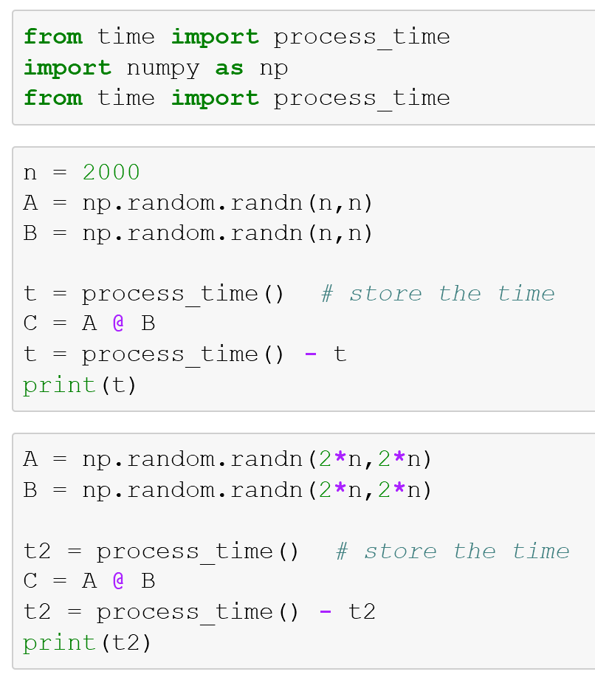
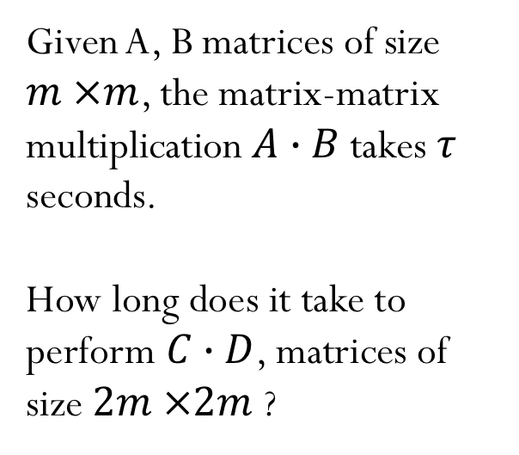
Complexity
How long does it take to solve a problem?
Given A, B matrices of size $m ×m$, the matrix-matrix multiplication $A∙B$takes $τ$ seconds.
How long does it take to perform $C∙D$, matrices of size $2m ×2m$ ?
Notes:
Write with approximate notation. Double the problem size, the time to solve a matrix-matrix multiplication grows by a factor of 8.
Students don’t get the same time. Even after running twice for the same computer, the time is not the same. The result depends on the state of the system and

Slide 16
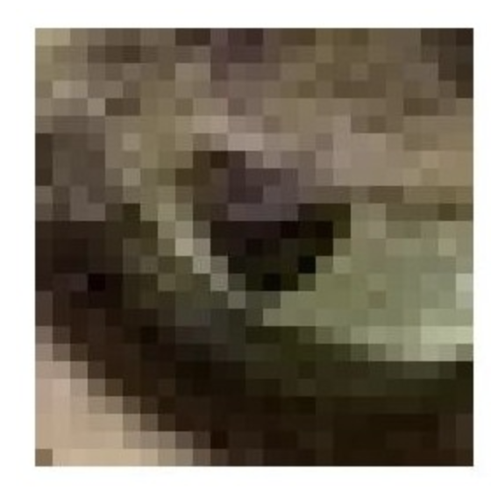
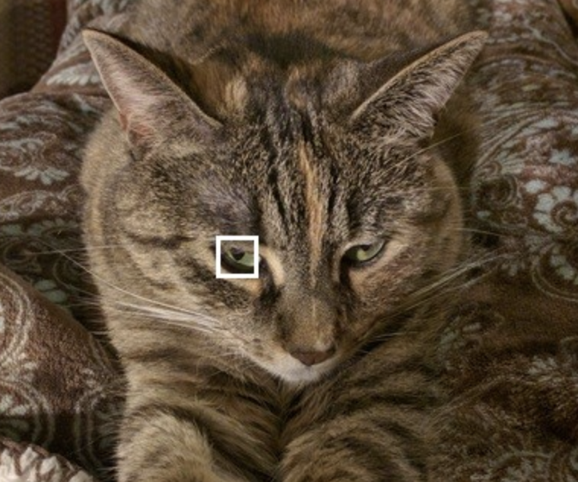
Linear system of equations: Image processing
How can we use linear operators to create blurred images? How can we do the inverse process?
Image credit: https://datacarpentry.org/image-processing/

Slide 17
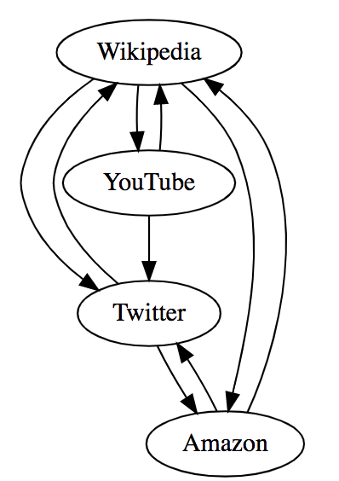
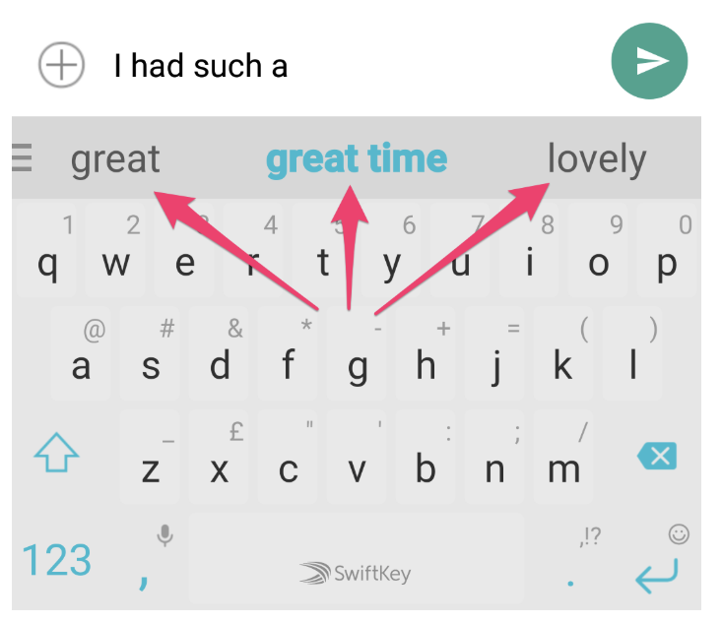
Markov chain
Page Rank
Word prediction

Slide 18
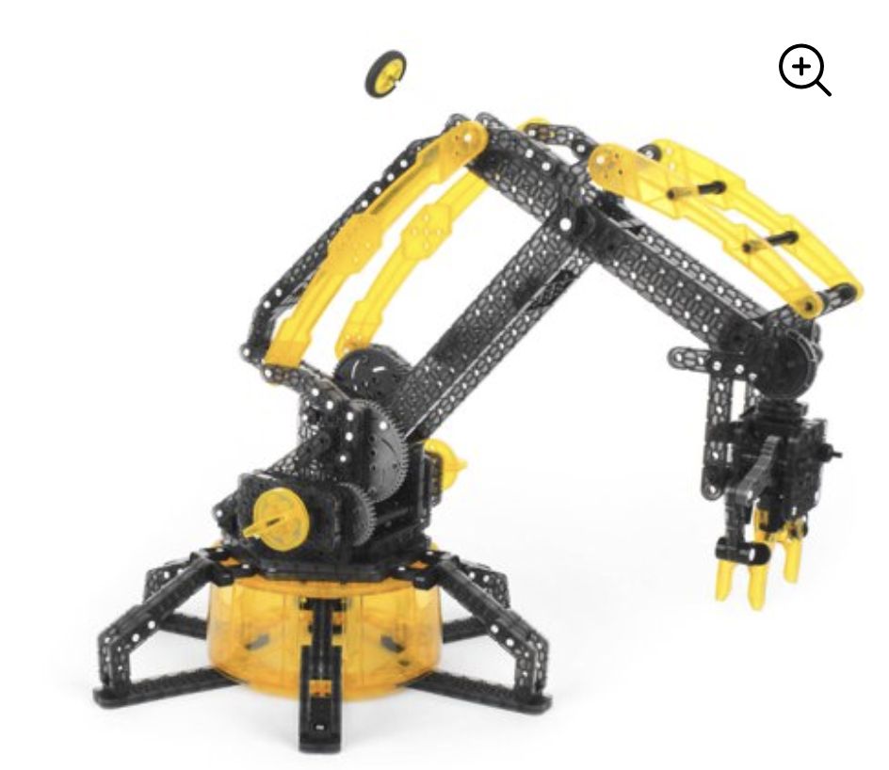

Nonlinear system of equations
Inverse kinematics: find the angles that make the robotic hand grab a chocolate candy!

Slide 19

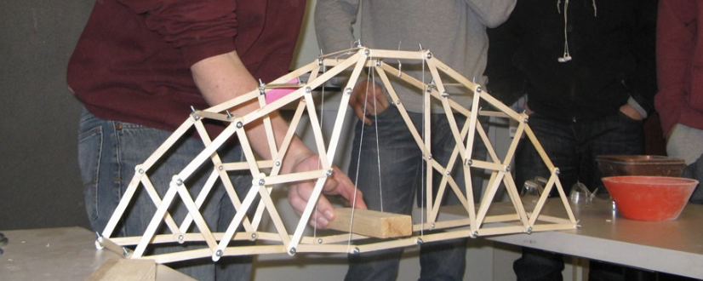
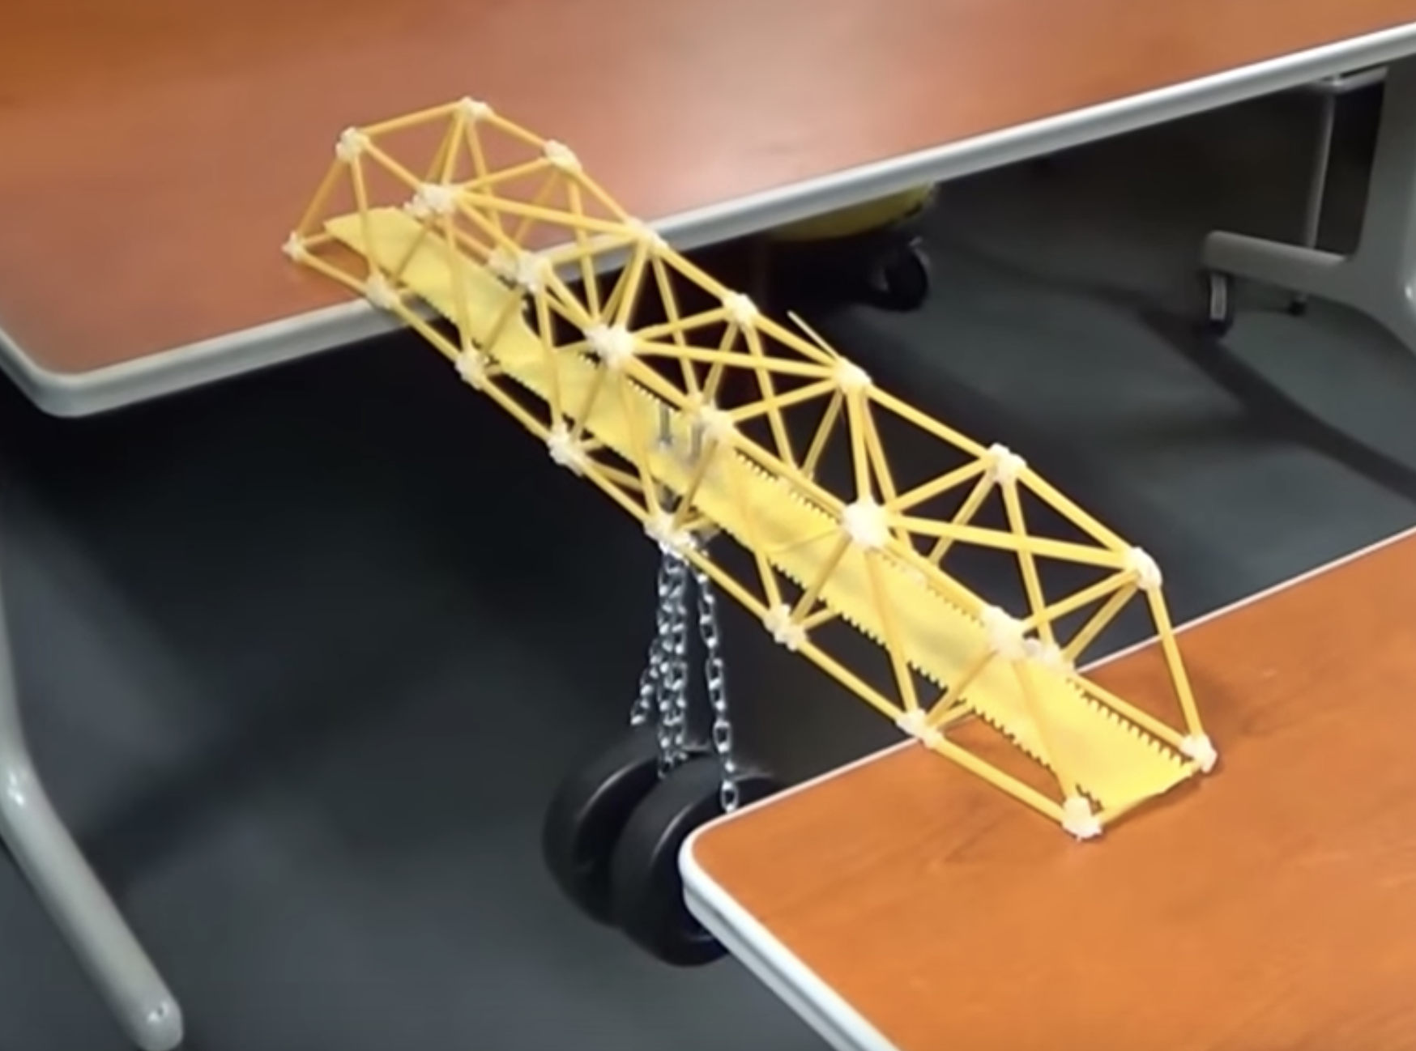
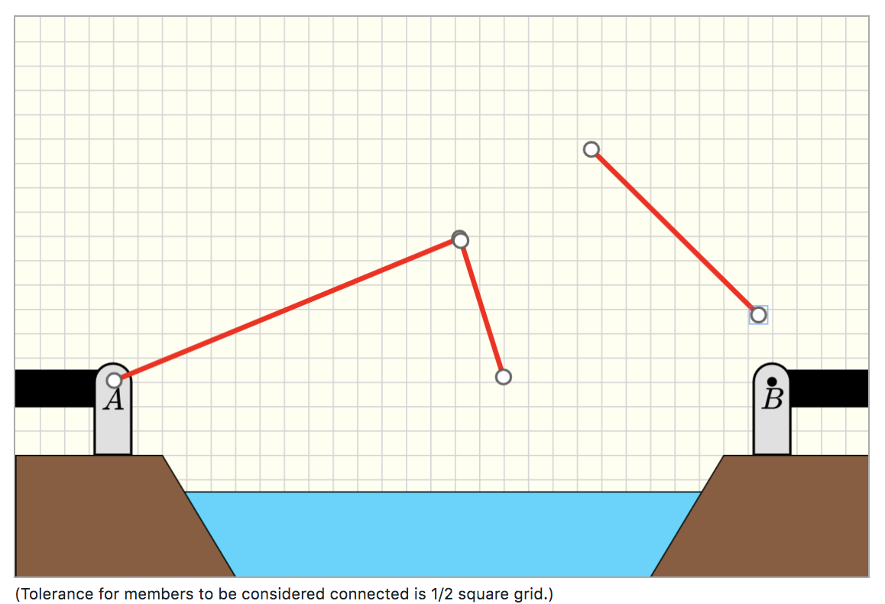
Optimization
Numerical simulations to find optimized bridge designs
Bridge design (high school projects)
http://cs357-stu-01.cs.illinois.edu/

Slide 20
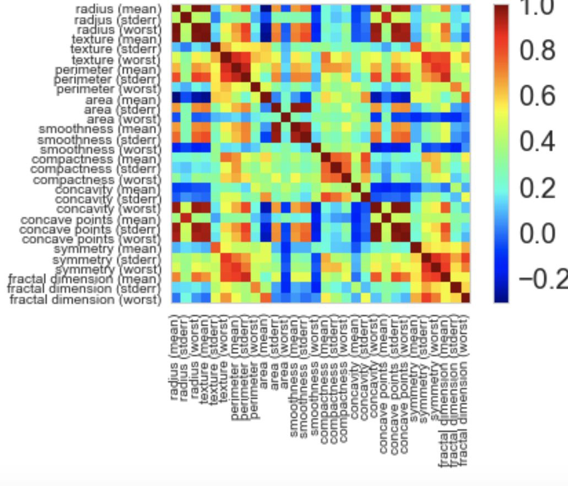
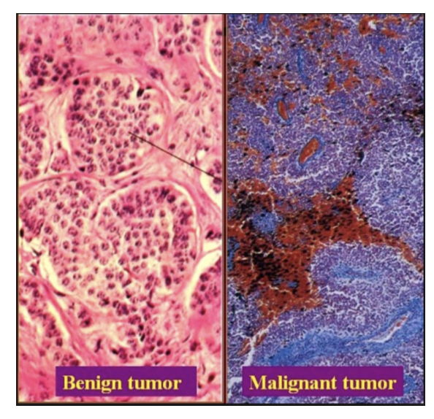
Linear Least Squares
Dataset containing the characteristics of cells for several patients. Can we make predictions if cells are benign or malignant?

Slide 21
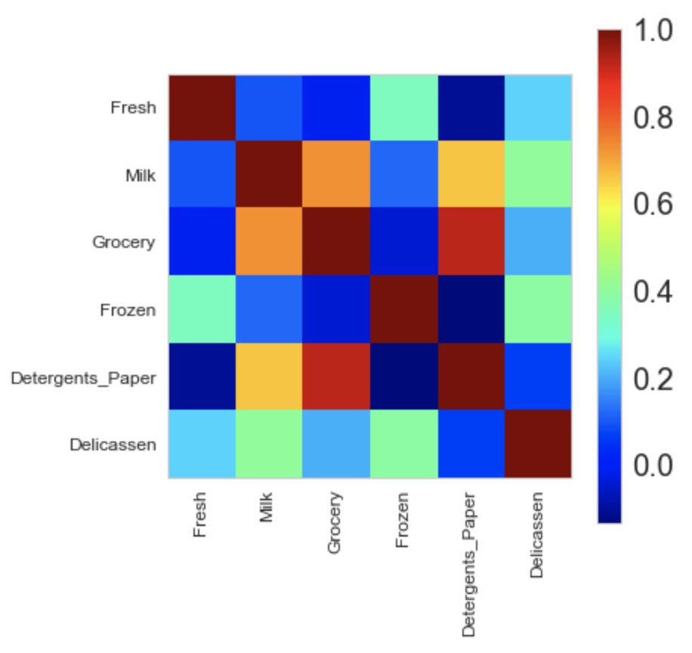
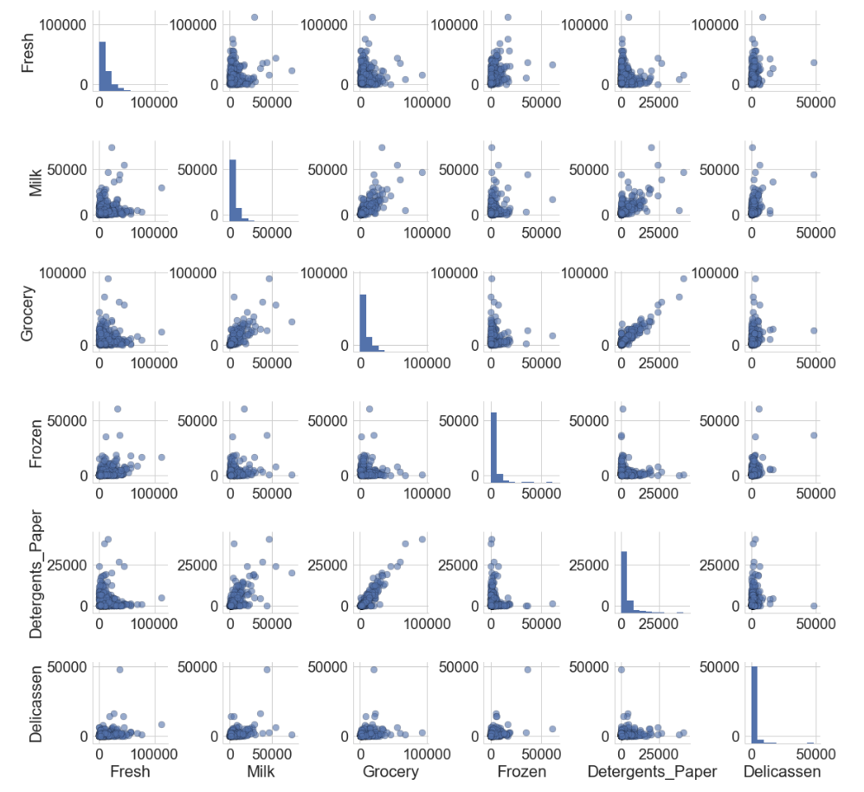
Principal component analysis
Sometimes our dataset has too many features? How can we reduce the feature space and still keep the most important information?

